Slide 1
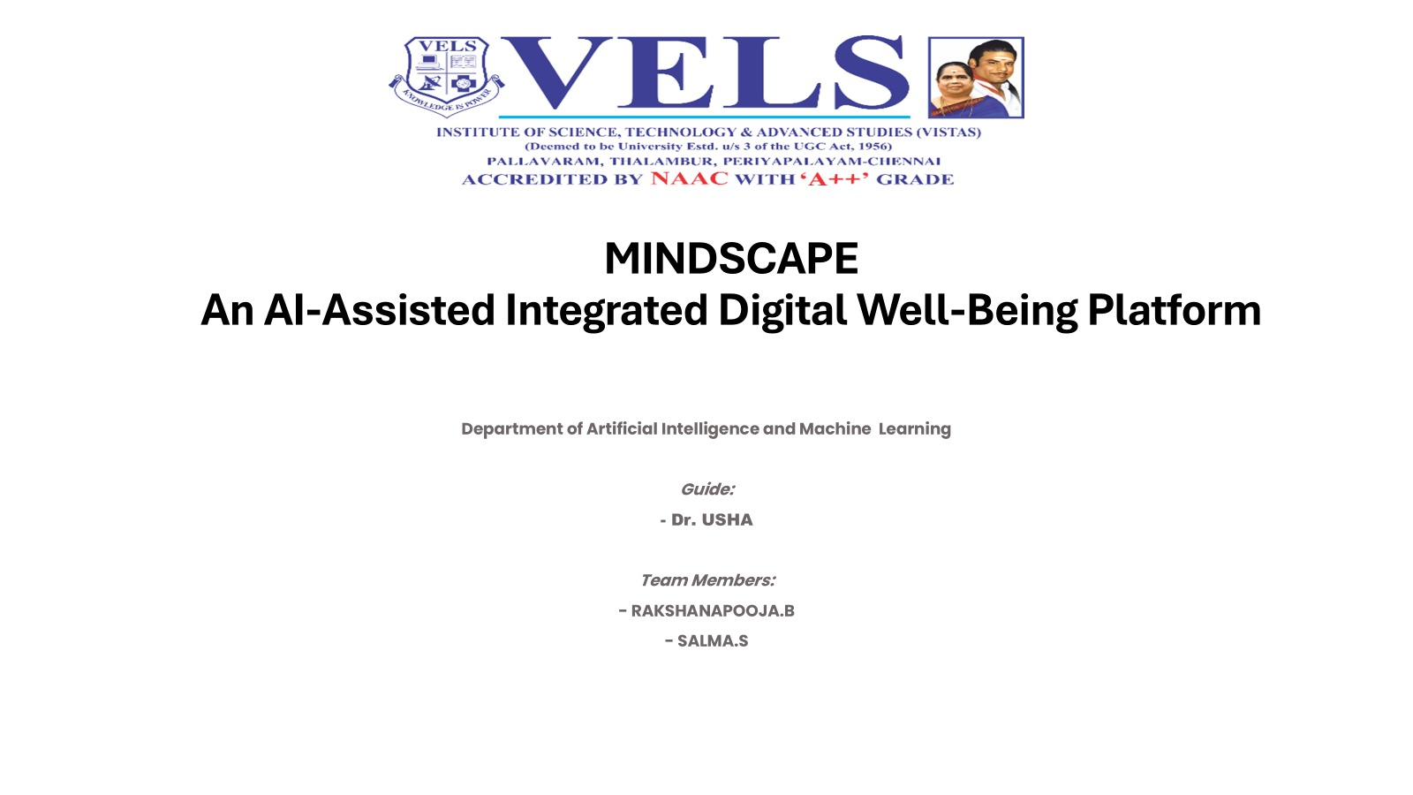

Slide 2
THE BIG PICTURE
Introduction
MindScape is an AI-assisted, integrated digital well-being platform. It brings emotional journaling, mood tracking, habit and focus management, grounding activities and safety-checked AI reflection together in one privacy-first web application.
1
2
Unified
Safety-aware
13+ modules in a single workspace
Risk screening runs before any AI reflection
3
4
POSITIONING
A self-reflection support tool. It is not designed for clinical diagnosis or treatment.
Private by design
Reflective
Data stays in browser localStorage
Journaling, gratitude and self-understanding tools
MindScape | AI-Assisted Integrated Digital Well-Being Platform
2 / 24

Slide 3
WHAT WE AIM TO BUILD
Objectives
PRIMARY OBJECTIVE
To design and develop an AI-assisted integrated digital platform for emotional journaling, self-understanding, personal reflection and well-being management.
1
2
3
4
Emotional Journal
Mood Tracking
Self-Understanding
Habit & Focus
Record dreams, thoughts, moods and categories
Monitor emotional patterns over time
Structured reflection and thought-pattern tools
Task management and habit tracking
5
6
7
8
Gratitude & Grounding
Progress Analytics
Achievements & Library
Safe AI Reflection
Healing activities and emergency grounding
Calendar view and Life Balance Wheel
Activity-based badges and curated wisdom
Risk-screened AI reflection with data export
MindScape | AI-Assisted Integrated Digital Well-Being Platform
3 / 24

Slide 4
GROUNDING THE APPROACH
Literature Review
Six key research papers form the foundation of this project.
No. | Research Paper | Year | Key Contribution
1 | AI-driven mental health therapy: comparative study of emotional clarity & stigma reduction | 2026 | Compares journaling, human therapy and AI-guided reflection
2 | ZenLoop: An AI-Powered Mental Health Platform | 2025 | AI conversational support with mood tracking and self-help tools
3 | AI-Based Mental Health Chatbot with Journaling, Mood Tracking & Emergency SOS | 2026 | Emergency crisis detection alongside mood and journaling
4 | The Personal Mental Wellbeing Assistant (Mood, Journal, Habits, Recommendations) | 2025 | Combines habit management with journaling and mood tracking
5 | AI Mood Tracking Application | 2025 | ML models tracking long-term mood fluctuations
6 | Emotional Journal with Mood Tracking | 2025 | NLP analysis of text-based mood and journal entries
MindScape | AI-Assisted Integrated Digital Well-Being Platform
4 / 24

Slide 5
WHERE THE FIELD FALLS SHORT
Research Gap
EXISTING SYSTEMS
PROPOSED IMPROVEMENT: MINDSCAPE
Single-purpose chatbots or reactive SOS features
One safety-checked environment that unifies:
×
Emotional journaling
×
Standalone mood tracking without deeper context
Mood tracking
Self-understanding
×
Isolated expressive / journaling text processing
Habit & focus management
Gratitude & grounding
×
No unified multi-module architecture
Progress analytics & Life Balance Wheel
Safety-aware AI reflection
Existing implementations remain fragmented, focused on isolated capabilities rather than an integrated, safety-checked well-being platform.
MindScape | AI-Assisted Integrated Digital Well-Being Platform
5 / 24

Slide 6
HOW IT COMES TOGETHER
Proposed Methodology
Every user interaction follows a structured six-stage workflow, from raw input to safety-checked AI reflection.
1
2
3
4
5
6
User Interaction
Data Acquisition
Data Persistence
Data Processing
Visualization
AI Reflection
Journal entries, moods, habits, tasks and gratitude records
Inputs converted into structured data objects
Stored locally via browser localStorage
JavaScript computes mood stats, streaks and progress
Charts, calendars, badges and the Life Balance Wheel
Risk-screened prompt sent to the AI Reflection API
Privacy note
Stages 1 to 5 run entirely in the browser. Only the risk-screened prompt in stage 6 goes to the external AI API.
MindScape | AI-Assisted Integrated Digital Well-Being Platform
6 / 24

Slide 7
UNDER THE HOOD
Layered System Architecture
USER · Web browser (Chrome / Edge / Firefox)
DESIGN PRINCIPLES
Presentation Layer
What the user sees
Modular
Login
Dashboard
Journal
Habits
Analytics
Settings
Each feature is an independent module
events / render
Application Layer
Business logic modules
Client-side
Navigation
Journal
Habits
Analytics
Calendar
Achievements
No backend server; data lives in the browser
Vision Board
Wisdom
AI
Risk Screening
Export / Import
read / write
Safety gate
Data Layer
Browser localStorage
Risk screening precedes every AI call
Entries
Gratitude
Tasks
Habits
Vision Board
Settings
Traditions
Preferences
Portable
Export / import keeps users in control
risk-screened prompt only
External Service Layer
Third-party API
AI Reflection API
MindScape | AI-Assisted Integrated Digital Well-Being Platform
7 / 24

Slide 8
WHAT IS INSIDE
Module Architecture
Capture
Manage
LIFE BALANCE WHEEL
Radar view of life areas, sample data
Emotional Journal
Focus & Habit Manager
Gratitude Journal
Task Management
Mood Tracking
Vision Board
Self-Understanding
Insight
Support
Progress Analytics
Grounding Activities
Calendar View
Safe AI Reflection
Life Balance Wheel
Resource & Wisdom Libraries
Achievements & Badges
Data Export / Import
MindScape | AI-Assisted Integrated Digital Well-Being Platform
8 / 24

Slide 9
SAFE BY DESIGN
AI Reflection & Risk Screening
User entry
Journal or mood input
Risk screening
Preliminary check
clear
AI Reflection API
Screened prompt sent
Reflection
Shown to the user
flagged
Grounding & support guidance
Calming activities shown before any AI response
Check first
Not clinical
Data stays local
Every entry passes a preliminary risk screening before the AI is called.
MindScape supports self-reflection. It does not diagnose or treat.
Entries live in browser localStorage; export or import at any time.
MindScape | AI-Assisted Integrated Digital Well-Being Platform
9 / 24

Slide 10
MODULE IMPLEMENTATION 1 / 3
Capture Modules: Journal & Mood
IMPLEMENTATION FLOW
Capture form
Journal text, category, mood and gratitude notes; voice input through Web Speech API
1
Structured data object
Each input becomes a dated object holding mood, category and text
2
Browser localStorage
Objects saved on the device, so no backend server is involved
3
Gratitude Journal
Self-Understanding
Render & statistics
JavaScript rebuilds the entry list and computes mood statistics
A quiet morning walk
Thought: "I always fail"
4
Support from a friend
Finished a hard task
Reframe: "I can learn from it"
Modules covered: Emotional Journal · Gratitude Journal · Mood Tracking · Self-Understanding
MindScape | AI-Assisted Integrated Digital Well-Being Platform
10 / 24

Slide 11
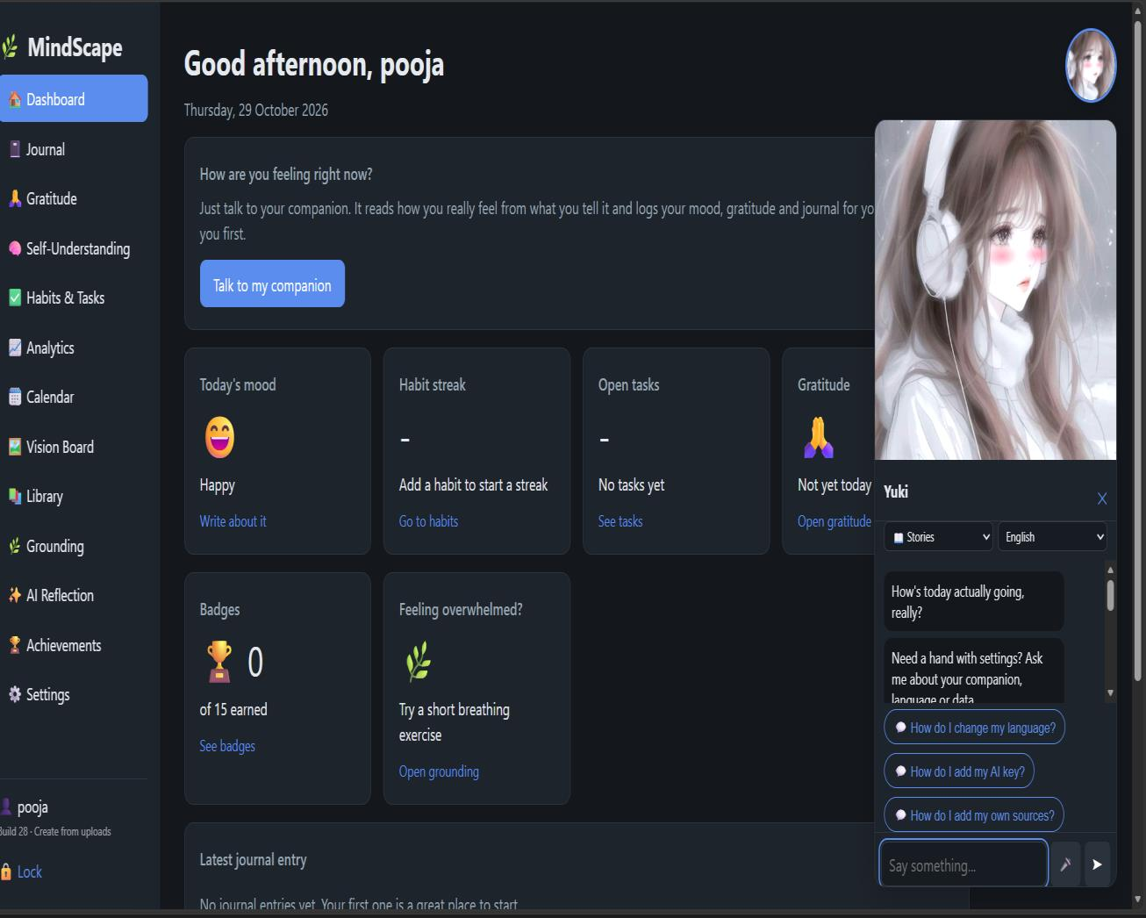
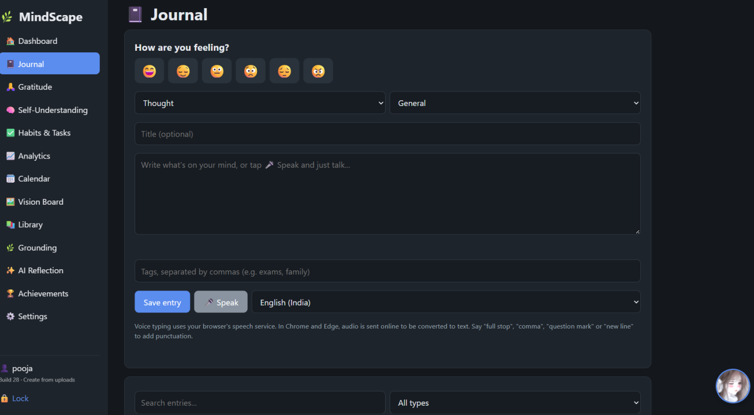
SCREENSHOTS 1 / 4
Dashboard & Journal
Journal and mood entry: pick a mood, write or speak, add tags
Modules covered
Emotional Journal and Mood Tracking. Entries are saved as dated objects in browser localStorage; voice input uses the Web Speech API.
Home dashboard: mood, streak, tasks, gratitude and the AI companion
MindScape | AI-Assisted Integrated Digital Well-Being Platform
17 / 24

Slide 12
MODULE IMPLEMENTATION 2 / 3
Manage & Insight Modules
PROCESSING ARCHITECTURE
Stored data
Habits, tasks, mood entries, settings and vision board items read from localStorage
JavaScript processing
Streak counts, completion rates, mood statistics, life-area scores and badge rules
Visual output
Canvas / SVG charts, calendar view, Life Balance Wheel and achievement badges
Modules covered: Habits · Tasks · Vision Board · Analytics · Calendar · Achievements
MindScape | AI-Assisted Integrated Digital Well-Being Platform
11 / 24

Slide 13
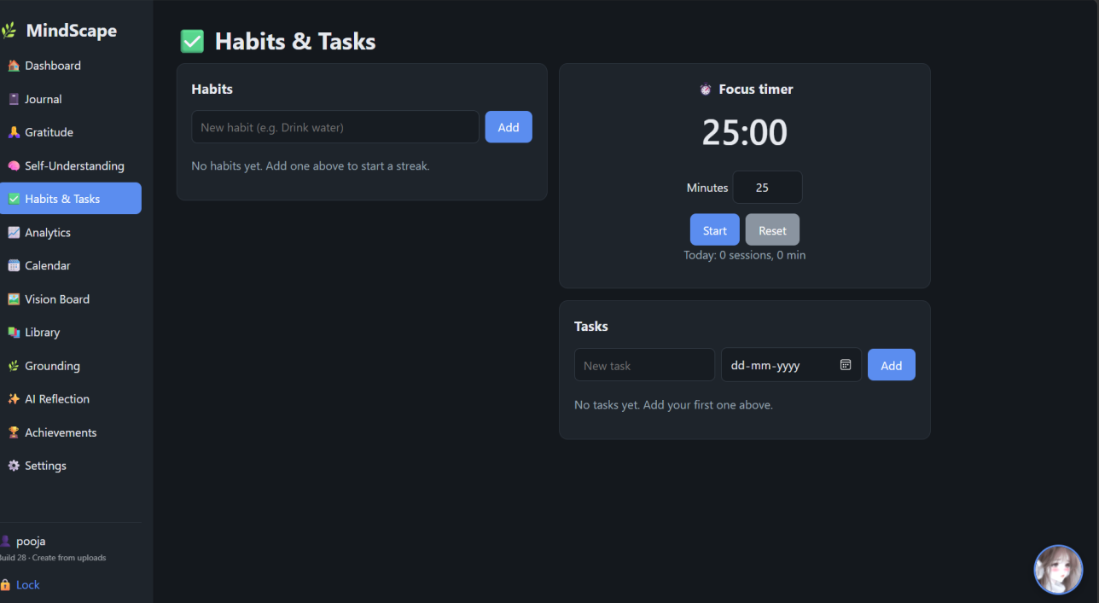
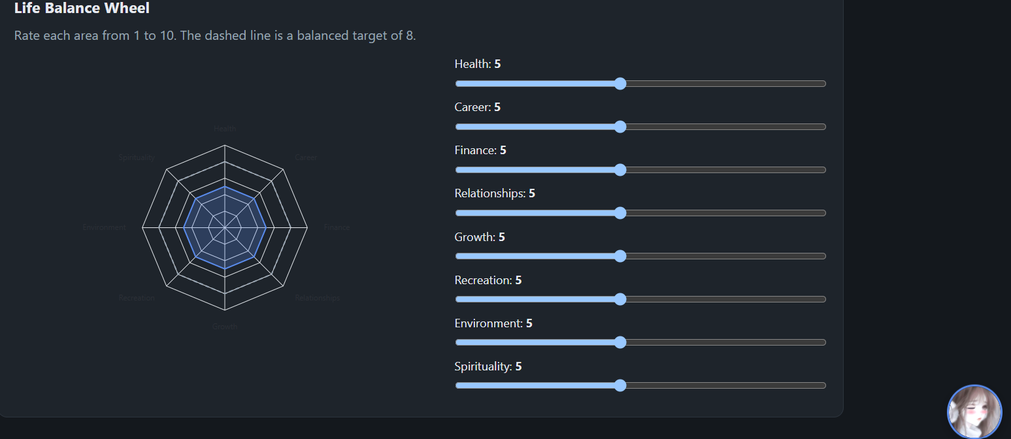
SCREENSHOTS 2 / 4
Habits, Focus Timer & Life Balance
Habit tracker, focus timer and tasks
Life Balance Wheel
Focus timer
Habits and tasks
Life Balance Wheel
A 25-minute session by default, with adjustable minutes, Start and Reset, and a count of today's sessions.
Add a habit to start a streak; tasks carry due dates and are counted in the analytics.
Eight life areas rated from 1 to 10 on sliders, drawn as a radar chart against a balanced target of 8.
MindScape | AI-Assisted Integrated Digital Well-Being Platform
18 / 24

Slide 14
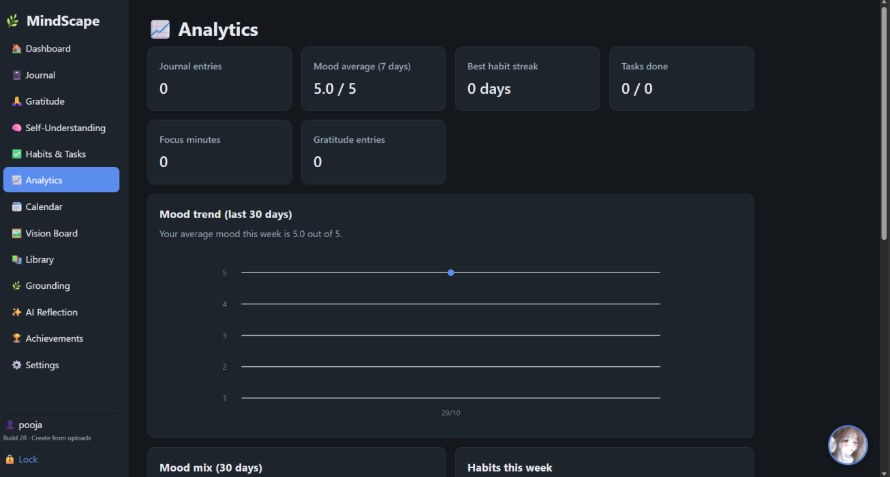
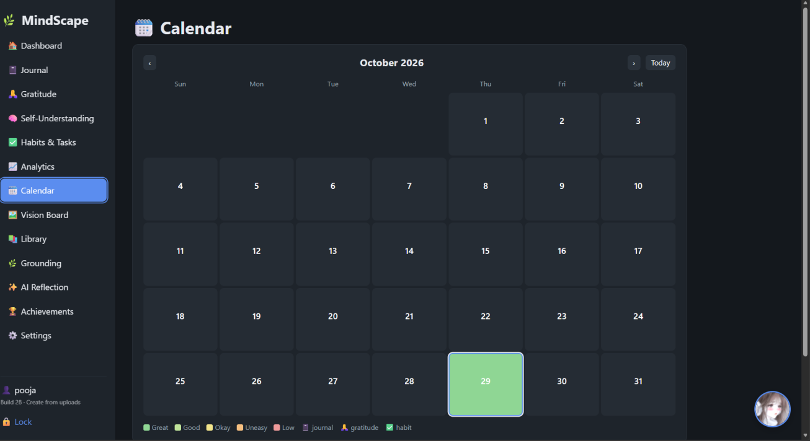
SCREENSHOTS 3 / 4
Analytics & Calendar
Progress analytics
Calendar view
Progress at a glance
Mood trend
Mood calendar
Journal entries, 7-day mood average, best habit streak, tasks done, focus minutes and gratitude entries.
A 30-day line chart and a mood mix, computed in JavaScript from the saved entries.
Each day is coloured from Great to Low, with markers for journal, gratitude and habit activity.
MindScape | AI-Assisted Integrated Digital Well-Being Platform
19 / 24

Slide 15
MODULE IMPLEMENTATION 3 / 3
Support Modules: Safe AI & Export
EXECUTION BOUNDARY
Runs in the browser
Entry input
Journal or mood text
Risk screening
Preliminary check on every entry
Prompt builder
Only the screened prompt is kept for the API
External AI Reflection API
Receives the risk-screened prompt only
Flagged entries show grounding & support guidance before any AI response.
MindScape | AI-Assisted Integrated Digital Well-Being Platform
12 / 24

Slide 16
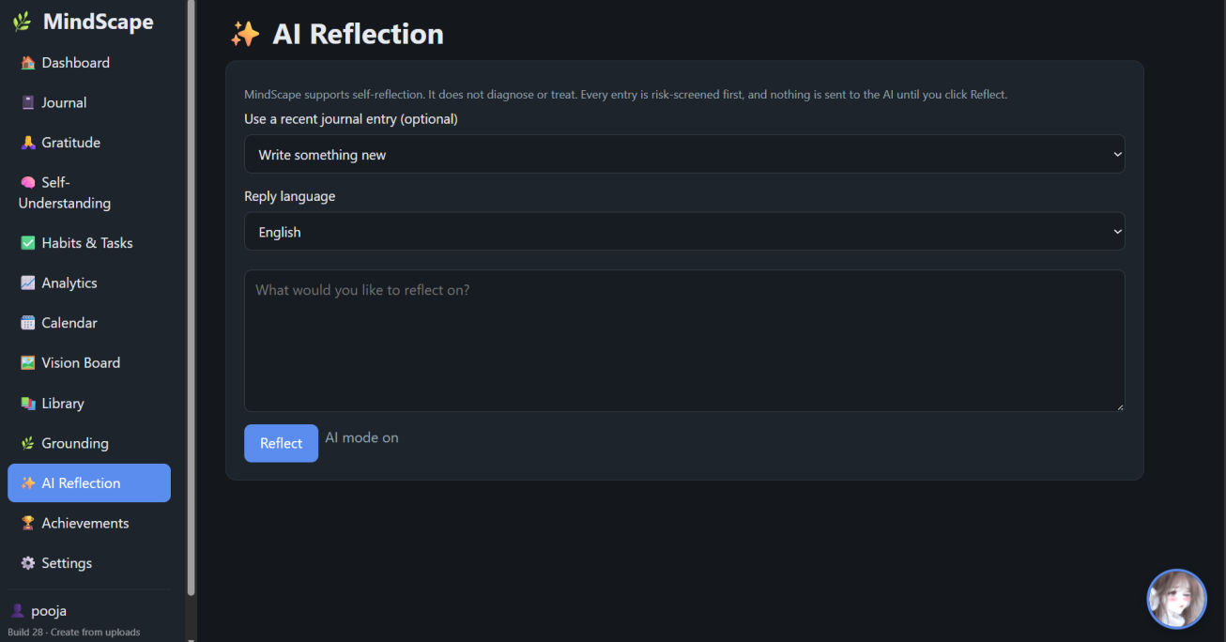
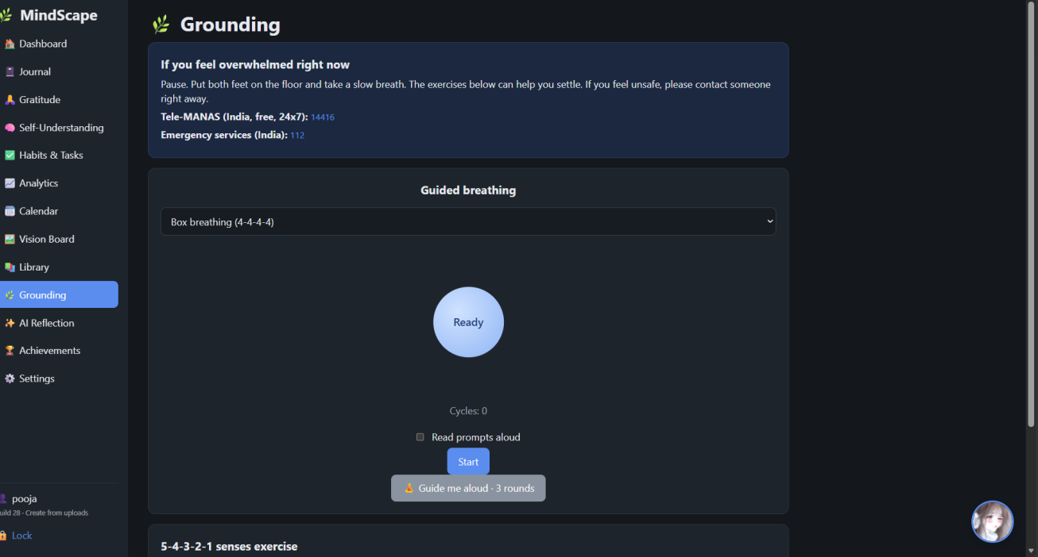
SCREENSHOTS 4 / 4
AI Reflection & Grounding
Risk-screened AI reflection
Grounding and breathing
Check first
Not clinical
Help always visible
Every entry is risk-screened, and nothing is sent to the AI until the user clicks Reflect.
The panel states that MindScape supports self-reflection and does not diagnose or treat.
Tele-MANAS (14416) and emergency services (112) are shown at the top of the grounding page.
MindScape | AI-Assisted Integrated Digital Well-Being Platform
20 / 24

Slide 17
FINAL REVIEW · TESTING
Testing & Results
ID | Module | Result
TC-01 | Journal | Entry persists correctly across a full page reload
TC-02 | Risk screening | Crisis-indicating text opens the grounding overlay; API call is skipped
TC-03 | AI Reflection | Structured output is rendered separately from journal entries
TC-04 | Vulnerability Index | Gauge and score update transparently with slider input
TC-05 | Settings | Full data export/import restores state after storage was cleared
HOW IT WAS VERIFIED
Manual functional testing of every module
1
HTML tag-balance verification
2
JavaScript syntax validation
3
DOM cross-check: every element used in the code exists in the markup
4
Validation scope
Functional and structural testing only. No human-subjects evaluation of the psychological effects of MindScape has been conducted.
MindScape | AI-Assisted Integrated Digital Well-Being Platform
21 / 24

Slide 18
WHAT IT RUNS ON
Hardware & Software Requirements
HARDWARE
SOFTWARE
Processor
Intel Core i3 (recommended: i5)
OS
Windows / Linux / macOS
IDE
Visual Studio Code
RAM
4 GB (recommended: 8 GB+)
Frontend
HTML5, CSS3, JavaScript
Storage
10 GB free space
Storage engine
Browser localStorage
Internet
Required for AI API interaction
AI integration
External AI Reflection API
Browsers
Chrome / Edge / Firefox
BROWSER APIs USED
Web Speech API (voice input)
SpeechSynthesis API (voice output)
Canvas / SVG (visualization)
External AI API (reflection)
MindScape | AI-Assisted Integrated Digital Well-Being Platform
13 / 24

Slide 19
FINAL REVIEW · FINAL BUILD
What the Final Build Adds
1
Mood check-in chat
2
Auto-logging with consent
3
Free AI key option
The companion greets first, reads the real mood from the story you tell, and asks “am I right?” before saving it.
Gratitude, journal and mood lines found in chat are offered to you and saved only after you say yes.
One key box accepts a free Google Gemini key or an Anthropic Claude key; the app picks the provider itself.
4
Create from uploads
5
Male and female voices
6
Five languages
A photo, PDF, Word file, audio, video or YouTube link becomes an original story, song or poem.
Each anime character speaks with a matching male or female voice and pitch.
The companion follows the user's language: English, Tamil, Malayalam, Telugu or Hindi.
Verified with simulated AI replies and automated browser tests. Evaluation with real users is future work.
MindScape | AI-Assisted Integrated Digital Well-Being Platform
22 / 24

Slide 20

PROJECT TIMELINE
Milestone Schedule
M1
M2
M3
Project Abstract
Review 1
Review 2
Final Review
MindScape | AI-Assisted Integrated Digital Well-Being Platform
14 / 24

Slide 21
WHAT SUCCESS LOOKS LIKE
Expected Outcome & Future Scope
A unified, modular and user-centered well-being platform. Users record experiences, monitor emotional patterns, track habits and receive safety-checked AI reflections, with complete data privacy through local storage and export / import.
FUTURE SCOPE
1
On-device ML for mood classification
2
Encrypted optional cloud sync
13+
100%
3
Mobile app / installable PWA
Integrated modules
Local data privacy
4
Multilingual journaling and voice
6
1
5
Clinician-shareable export reports
Research papers reviewed
Safety-checked AI pipeline
MindScape | AI-Assisted Integrated Digital Well-Being Platform
23 / 24

Slide 22
REVIEW 3
Final Review
Implementation, Testing and Results
01
02
03
04
Implementation
Testing & Results
Final Build
Conclusion
Live screenshots of the running application
Functional and structural validation
Companion, free AI key, uploads and voices
Outcome achieved and future scope
Rakshanapooja B (24623123) · Salma S (24623125) | Guided by Dr. Usha

Slide 23
PROJECT PLAN
Gantt Chart
Activity | Jul | Aug | Sep | Oct
Problem Identification
Requirement Analysis
Literature Survey (20 papers)
Research Gap Analysis
System Architecture
UI/UX Design
Login & Dashboard
Journal & Gratitude
Self-Understanding
Focus & Habits
Analytics & Calendar
Vision Board & Resources
AI Reflection & Risk Check
Module Integration
Testing & Debugging
Final Results
Documentation
Final Presentation
MindScape | AI-Assisted Integrated Digital Well-Being Platform
15 / 24

Slide 24
CONCLUSION
Thank You
MindScape: An AI-Assisted Integrated Digital Well-Being Platform
PROBLEM ANALYZED
SOLUTION PROPOSED
Fragmented well-being tools with isolated, single-purpose AI capabilities
A unified, safety-checked platform combining journaling, mood, habits and AI reflection
Rakshanapooja B (24623123) · Salma S (24623125)
Guided by Dr. Usha | Department of Artificial Intelligence and Machine Learning

